Slide 1
Scikit-Learn’s Grid Search API
GROUP 3: Xiaoyu Wang, Adhira Deogade

Slide 2
Grid Search in Scikit-Learn API
Hyperparameter optimization is a big part of deep learning.
The reason is that neural networks are notoriously difficult to configure and there are a lot of parameters that need to be set. On top of that, individual models can be very slow to train.
So we will discover how to use the grid search capability from the scikit-learn python machine learning library
To tune the hyperparameters of Keras deep learning models.

Slide 3
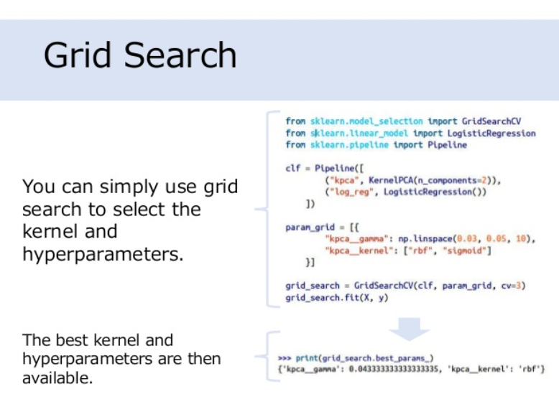

Slide 4
How to use Keras Models in Scikit-Learn?

Slide 5
Two Wrappers
keras.wrappers.scikit_learn.KerasClassifier(build_fn=None, **sk_params)
Implements the Scikit-Learn classifier interface
keras.wrappers.scikit_learn.KerasRegressor(build_fn=None, **sk_params)
Implements the Scikit-Learn regressor interface

Slide 6

Keras models can be used in scikit-learn by wrapping them with the KerasClassifier or KerasRegressor class.
To use these wrappers you must define a function that creates and returns your Keras sequential model, then pass this function to the build_fn argument when constructing the KerasClassifier class.
For example:

Slide 7
How to use Grid Search in Scikit-Learn?

Slide 8
Grid search is a model hyperparameter optimization technique. In scikit-learn this technique is provided in the GridSearchCV class. When constructing this class we must provide a dictionary of hyperparameters to evaluate in the param_grid argument.
This is a map of the model parameter name and an array of values to try

Slide 9
GridSearchCV
The GridSearchCV process will then construct and evaluate one model for each combination of parameters.
Cross validation is used to evaluate each individual model and the default of 3-fold cross validation is used.

Slide 10
By default, accuracy is the score that is optimized, but other scores can be specified in the score argument of the GridSearchCV constructor.
By default, the grid search will only use one thread. By setting the n_jobs argument in the GridSearchCV constructor to -1, the process will use all cores on your machine. Depending on your Keras backend, this may interfere with the main neural network training process.
For Example:

Slide 11
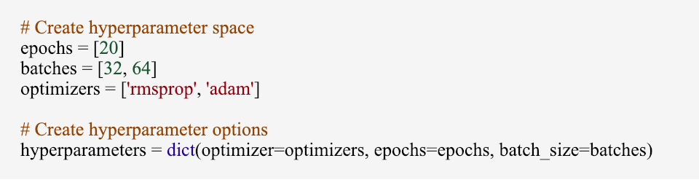
How to Tune the Hyperparameters?
Given the challenge of time, I decided to keep epochs constant and create a grid search for batch_size and optimizers

Slide 12
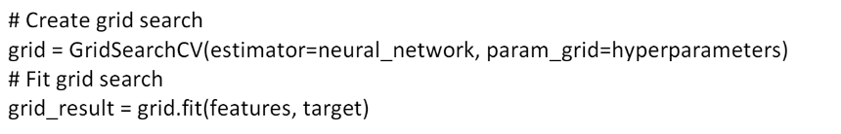
Conduct Grid Search & Find the Best

Slide 13
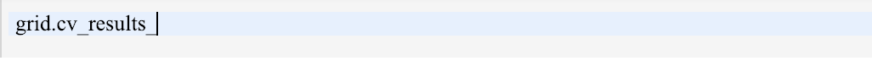
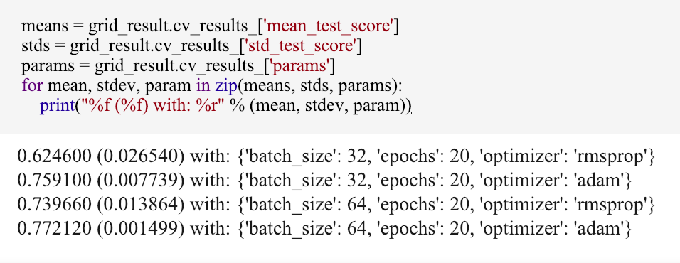
Final Results On CNN Model

Slide 14
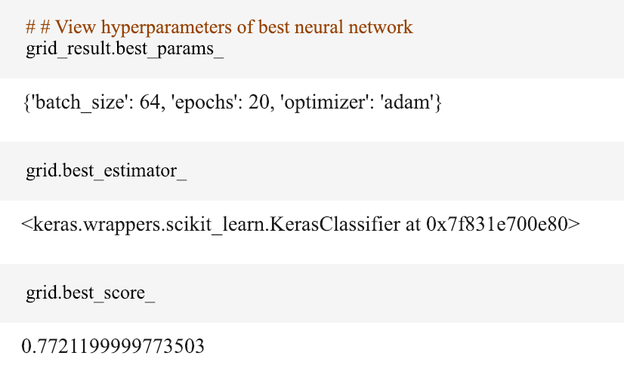
Find the Best

Slide 15
Tips For Hyperparameter Optimization
Review the Whole Grid.
Do not just focus on the best result;
Review the whole grid of results and look for trends to support configuration decision

Slide 16
Tips For Hyperparameter Optimization
K-fold Cross Validation
The results usually show some variance.
A default cross-validation of 3 was used, but perhaps k=5 or k=10 would be more stable. Carefully choose your cross validation configuration to ensure your results are stable.

Slide 17
Tips For Hyperparameter Optimization
Do Not Transfer Results
Results are generally problem specific.
Try to avoid favorite configurations on each new problem that you see.
It is unlikely that optimal results you discover on one problem will transfer to next project.
Instead look for broader trends like number of layers or relationships between parameters.

Slide 18
Thank You !

